Slide 1
PHYS4260 Quantum Mechanics II Spring 2025
Scattering Theory

Slide 2
Outline
Classical scattering of rigid spheres
Rutherford formula

Slide 3
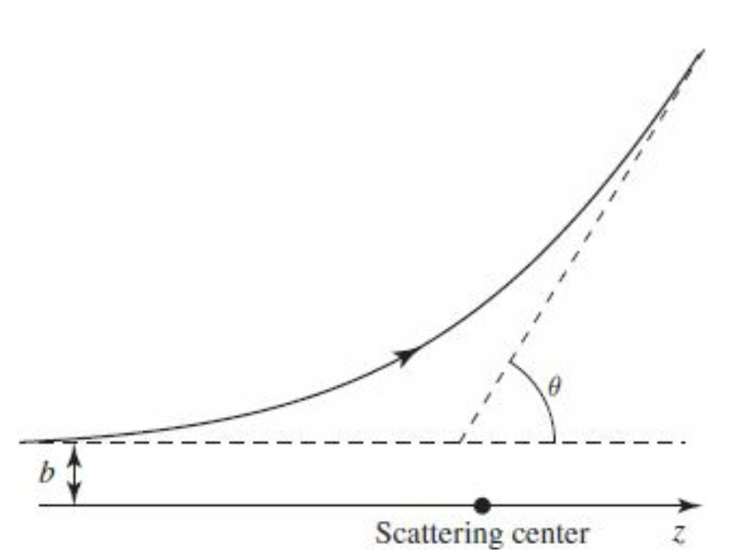
Re: Scattering theory: Classical
Imagine a particle incident on some scattering center (say, a marble bouncing off a bowling ball, or a proton fired at a heavy nucleus). It comes in with energy E and impact parameter b, and it emerges at some scattering angle θ—see Fig. (We’ll assume for simplicity that the target is symmetrical about the z axis, so the trajectory remains in one plane, and that the target is very heavy, so its recoil is negligible.) The essential problem of classical scattering theory is this:
Given the impact parameter, calculate the scattering angle.
Ordinarily, of course, the smaller the impact parameter, the greater the scattering angle.

Slide 4
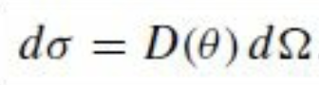
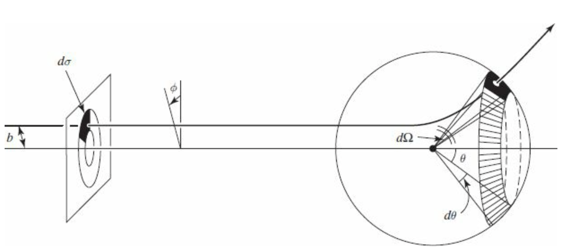
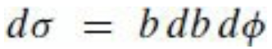
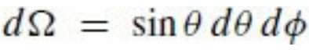
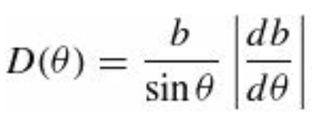
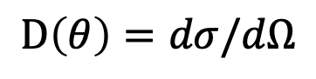
Re: Scattering theory: Classical
More generally, particles incident within an infinitesimal patch of cross-sectional area $dσ$ will scatter into a corresponding infinitesimal solid angle $dΩ$. The proportionality factor is a function of angle $θ$: $D\left(θ\right)=dσ/dΩ$
$$D\left(θ\right)=dσ/dΩ$$
In terms of the impact parameter and the azimuthal angle $φ$ and
Since θ is typically a decreasing function of b,
the derivative is actually negative—hence the
absolute value sign.

Slide 5
Scattering theory: Classical
More generally, particles incident within an infinitesimal patch of cross-sectional area $dσ$ will scatter into a corresponding infinitesimal solid angle $dΩ$. The proportionality factor is a function of angle $θ$: $D\left(θ\right)=dσ/dΩ$
$$D\left(θ\right)=dσ/dΩ$$
In terms of the impact parameter and the azimuthal angle $φ$ and
Since θ is typically a decreasing function of b,
the derivative is actually negative—hence the
absolute value sign.

Slide 6
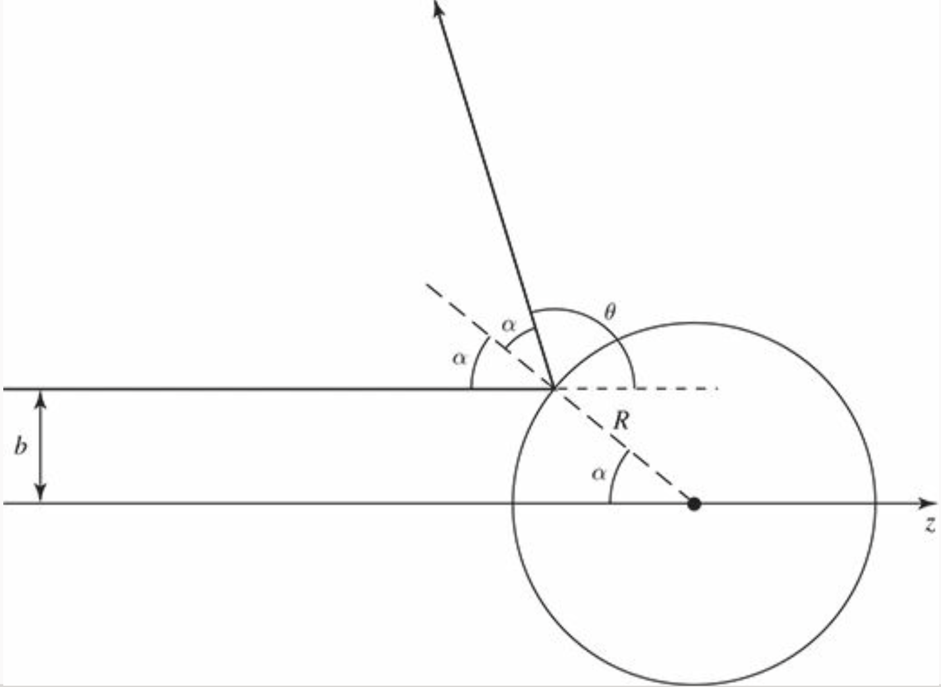
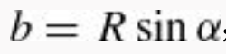
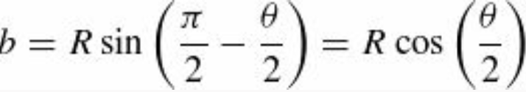
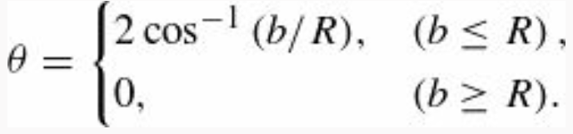
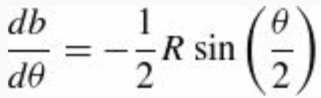
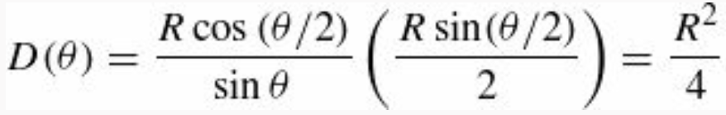
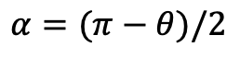
Scattering theory: Classical
Example: hard-sphere scattering.
$$α=(π−θ)/2$$
This example is unusual, in that $D\left(θ\right)$is independent of θ

Slide 7
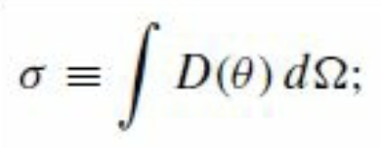
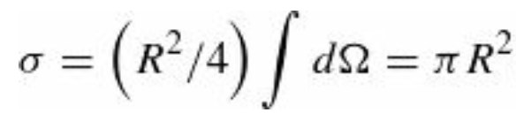
Scattering theory: Classical
The total cross-section is the integral of $D\left(θ\right)$over all solid angles:
As in the example of the hard-sphere scattering
which is just what we would expect: It’s the cross-sectional area of the sphere; billiard-balls incident within this area will hit the target, and those farther out will miss it completely. But the virtue of the formalism developed here, it applies just as well to “soft” targets (such as the Coulomb field of a nucleus) that are not simply “hit-or-miss”.
Finally, suppose we have a beam of incident particles, with uniform intensity (or luminosity, as particle physicists call it)

Slide 8
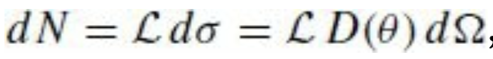
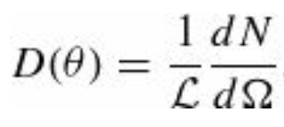
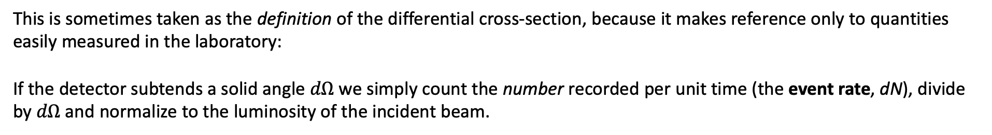
Scattering theory: Classical
The number of particles entering area $dσ$ (and hence scattering into solid angle $dΩ$ per unit time, is
And therefore,
This is sometimes taken as the definition of the differential cross-section, because it makes reference only to quantities easily measured in the laboratory:
If the detector subtends a solid angle $dΩ$ we simply count the number recorded per unit time (the event rate, dN), divide by $dΩ$ and normalize to the luminosity of the incident beam.

Slide 9
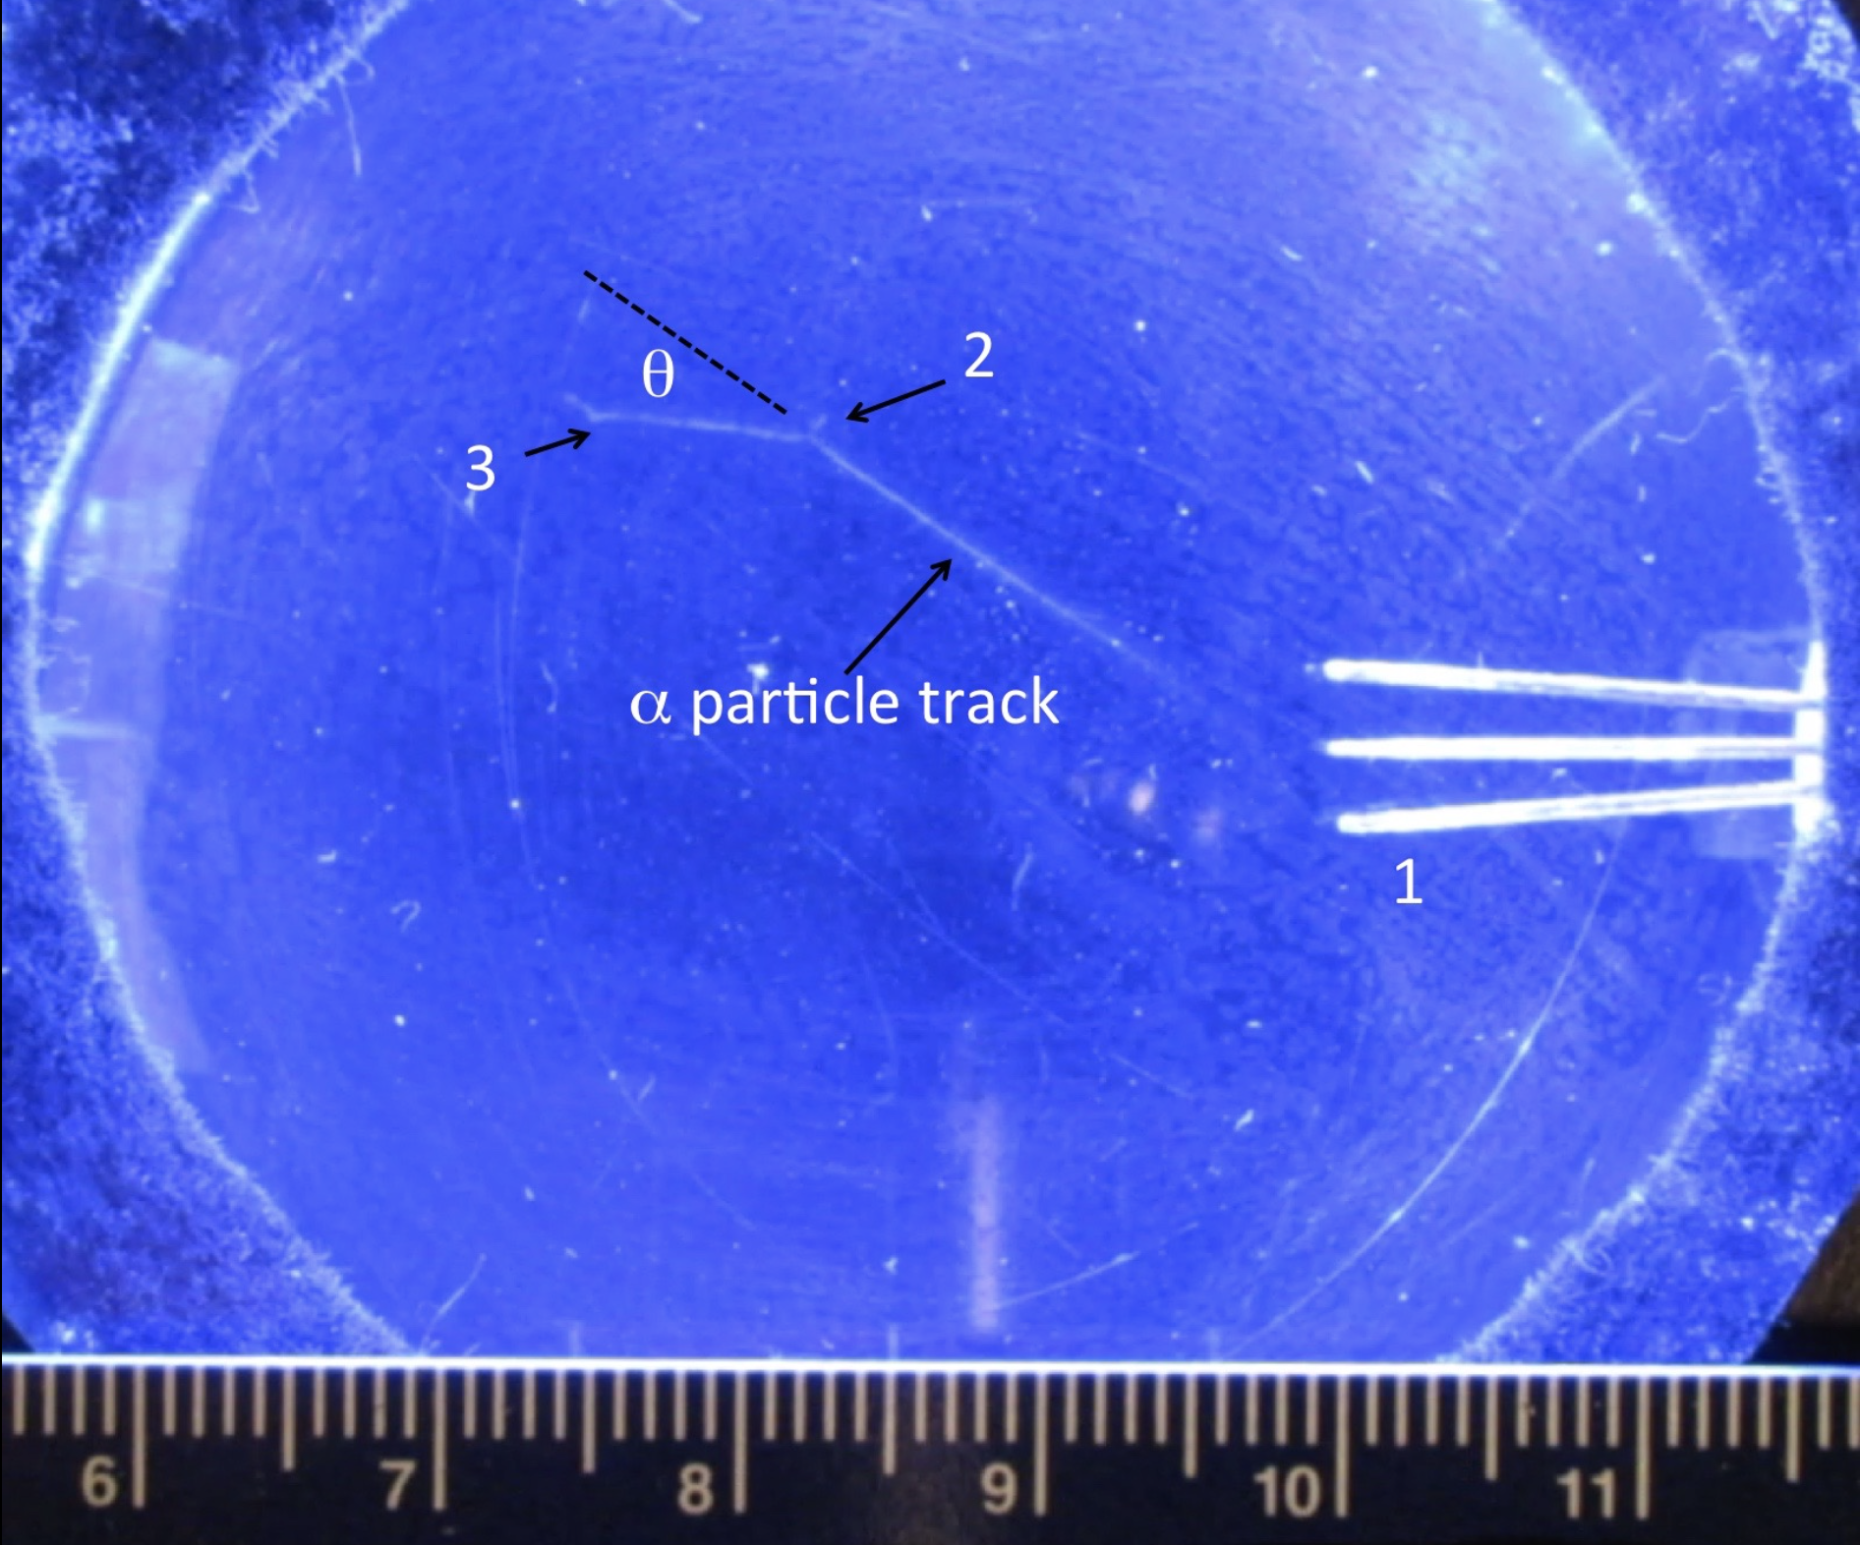
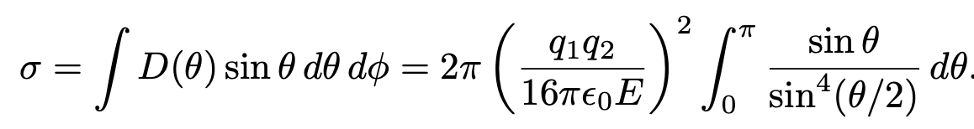
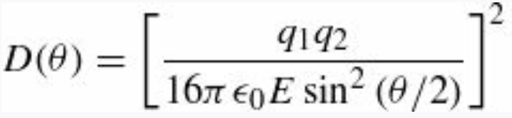
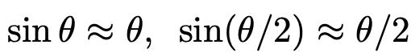
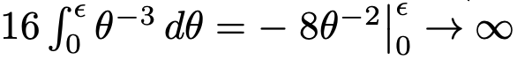
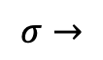
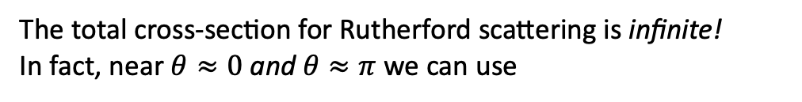
Scattering theory: Rutherford formula
The total cross-section for Rutherford scattering is infinite!
In fact, near $θ≈0$ and $θ≈π$ we can use
Then
$$σ→$$
In a cloud chamber, a 5.3 MeV alpha particle track from a lead-210 pin source near point 1 undergoes Rutherford scattering near point 2, deflecting by an angle of about 30°. It scatters once again near point 3 and finally comes to rest in the gas. The target nucleus in the chamber gas could have been a nitrogen, oxygen, carbon, or hydrogen nucleus. It received enough kinetic energy in the elastic collision to cause a short visible recoiling track near point 2. (The scale is in centimeters.)

